Slide 1

Data Statistics and Visualization
of
Social Media
Group 7
Members: Ao OUYANG、 Boshen MIN、Jianhua HUANG

Slide 2

1
Introduction
2
Crawl hot list data
CONTENTS
3
Make word cloud
4
Discussion

Slide 3
1
Introduction

Slide 4
1
Sample Selection Index
Hot Topic
Hope to observe the current social attention through the visual word cloud. Find out what people pay attention to.
vertical comparison
Look at how social concerns change over time
Horizontal Comparison
Observe the similarities and differences of
different popular websites

Slide 5
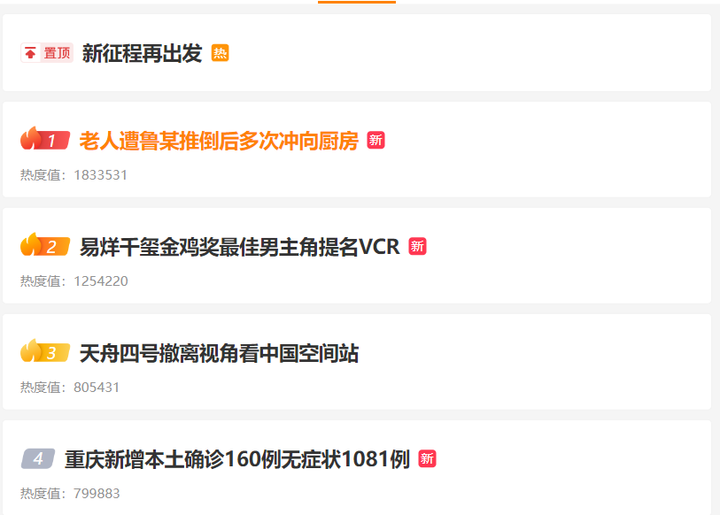
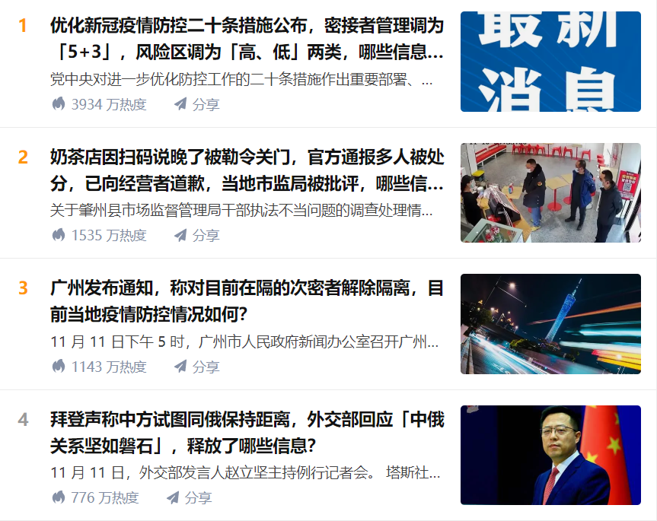
1
Mainstream media Websites in China
Zhihu
A question-and-answer platform.
In addition to news discussions, Zhihu Hot List will also have some technical questions, and some interesting and popular questions.
Weibo
Hot search in Weibo reflects affairs news and entertainment news

Slide 6
1
Steps
Generating word clouds
Analyze word clouds horizontally and vertically
Scraping
crawl hotlist data from Weibo and Zhihu
1
2
3
keyword extraction
Use two different keyword extraction methods,
and compare them

Slide 7
2
Crawl hot list data

Slide 8


2
Crawler tools
Beautiful Soup is a Python library that can extract data from HTML or XML files. It provides the usual way to navigate, find, and modify documents through your favorite converter. Beautiful Soup will save you hours or even days of work.
Selenium is an umbrella project for a range of tools and libraries that enable and support the automation of web browsers.

Slide 9
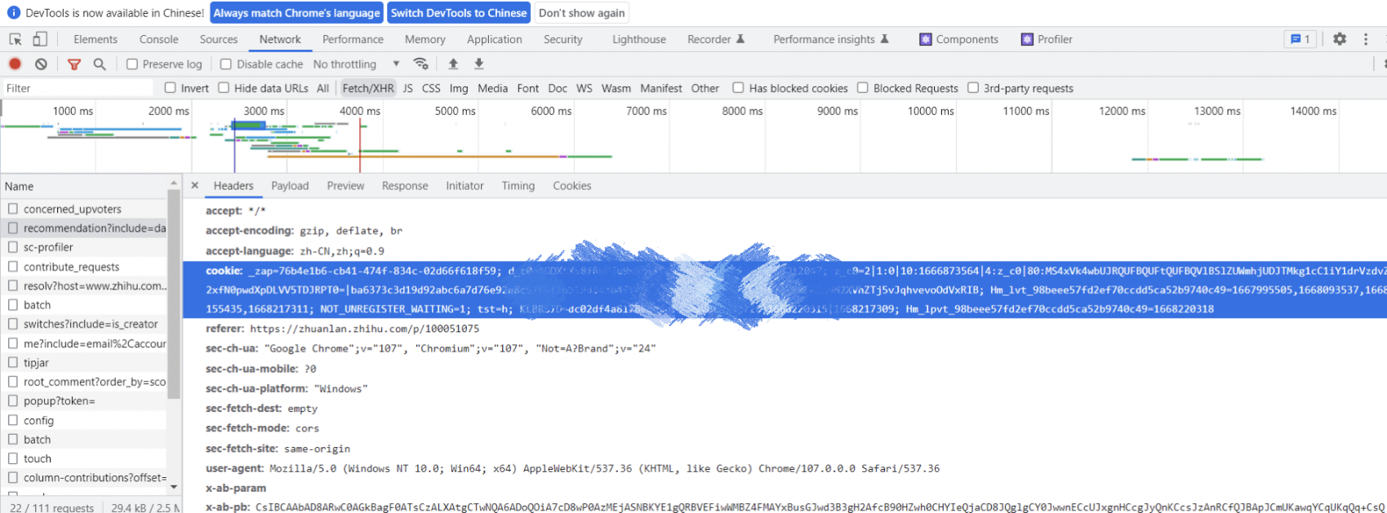
2
Take with Cookies
To bypass permission verification, we need Cookie in the request header
Use the developer tools, find the login status in the web request

Slide 10
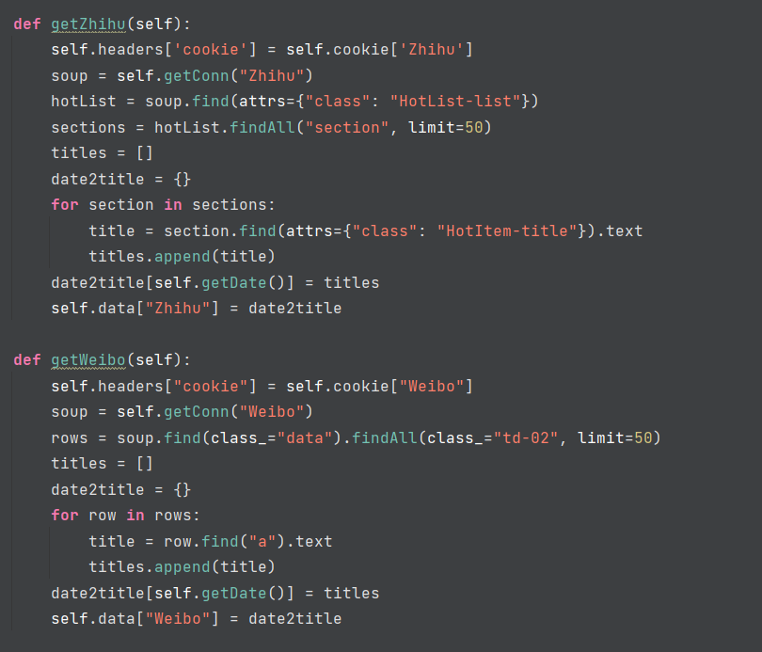
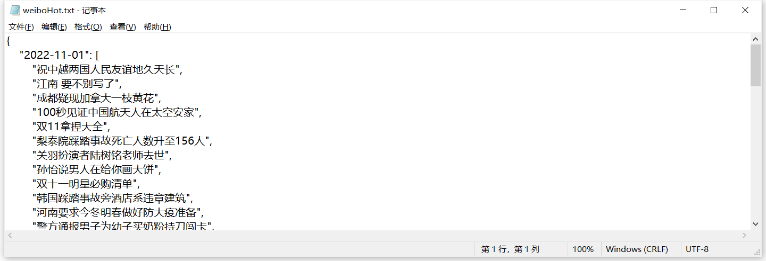
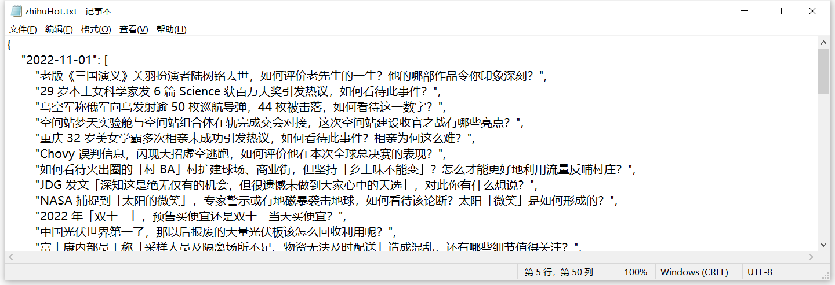
2
Process
After connecting to the site, we request the site text and use beautifulsoup to clean returned data.
We get the data corresponding to the hotlist tag using API find and find_all.
Store it in the dictionary and convert to json.

Slide 11
3
Word Cloud

Slide 12
3
Word Cloud
Extract words &
word frequency
Use a segment tool Jieba, to segment Chinese words. Use tf-idf & tf algorithm and compare their differences.
Import WordCloud library
Vertical comparison & Horizontal comparison
Word Cloud
Analyze the trending

Slide 13
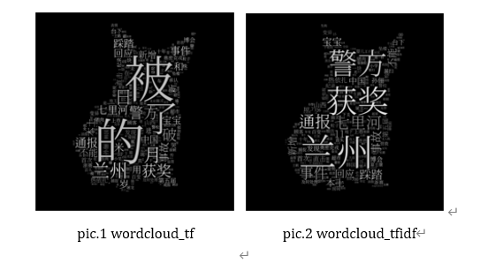
3
Compare TF and TFIDF
Analyze the result
For keyword extraction, the simplest method must be obtained by word frequency, and TF-IDF is a more advanced method.
When counting word frequency, we know that some meaningless words have very high word frequency. Obviously, these words cannot appear as keywords, so it is necessary to pay attention to word filtering.
When using Term Frequency algorithm directly, we can see some stop words such as “被”, “的” have high term frequency.

Slide 14
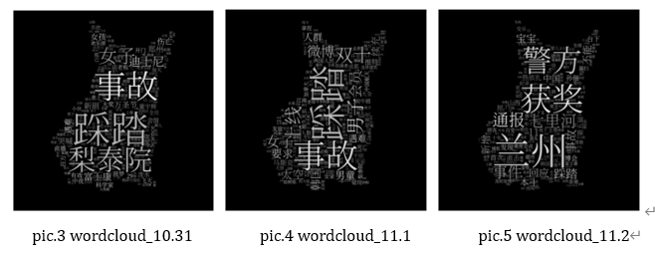
3
Vertical Comparation
To compare the time trend of the hot search keywords, we prepare hot search data of different days as the corpus, and show the keywords of a certain day.
Analyze the result
From the word clouds, Itaewon Stampede was the main focus of social from October 31 to November 1.

Slide 15
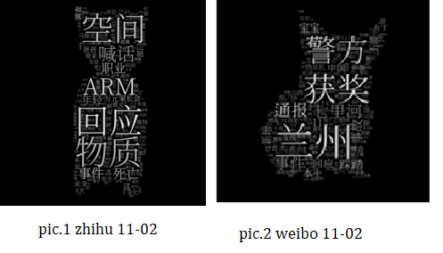
3
Horizontal Comparation
Compare the hot search data of Zhihu and Weibo on a given day
Analyze the result
Zhihu has some professional terms in its hot list, while Weibo is more of a daily news

Slide 16
4
Discussion

Slide 17
4
Discussion
Improvements
Beautify word cloud: Add various colors or enrich the pattern of the word clouds
Try more Keyword Extraction Algorithm.
Like TextRank
Create word frequency methods by ourselves.
A comprehensive keyword extraction algorithm can be obtained by weighting the above algorithm

Slide 18
THANK YOU

